Slide 1
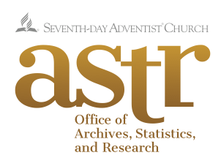
Research and digital resources: An agenda for the twenty-first century
D. J. B. Trim
Office of Archives, Statistics, and Research

Slide 2
Notes:
We live in a digital age—we are surrounded by numbers and encoded information, and that is true in multiple ways.

Slide 3
WE LIVE IN THE ERA OF BIG DATA
What does that mean?

Slide 4
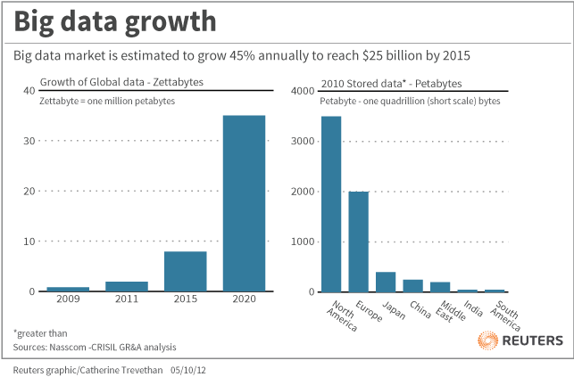
IT MEANS LOTS OF DATA—AND ABOUT LOTS OF THINGS
It may feel like it means learning a whole new language

Slide 6
It may mean learning a new conceptual language

Slide 7
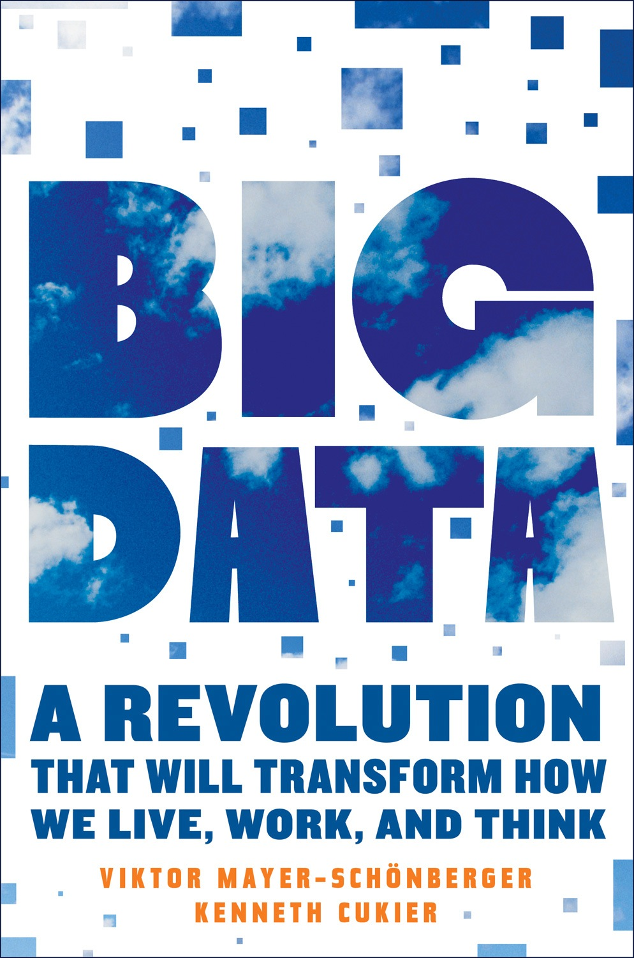
Big Data, we are told, will transform how we live, work, and think
But is it transforming how
the Church works and does business (how we go about “our Father’s business”)??
Are we utilising data?
Or just amassing it?
(Houghton Mifflin Harcourt, 2013)

Slide 8
Research and analysis are necessary if data is to be meaningful & useful
We can use widely available “big data” to enhance our outreach, but this requires expertise; Adventist colleges and universities have a key role to play.
The Seventh-day Adventist Church could collect its own data in different ways, using digital technology, which means it could also collect new types of data.
But the reason to collect new data is to improve our ministry and mission, which means it needs analysis.

Slide 9
Digital data can transform research, making it even more powerful
SO: “Big data” & the new types of denominational information that can be collected electronically will both be optimised by research
However, research can also be enhanced, in some cases even transformed, by the digital revolution…
Researchers need to make the most of “big data”
The denomination needs to make more information available electronically.

Slide 10
A new age for Adventist Studies
All this means that the Church needs to embrace research and analysis more than ever before.
Adventist scholars have the expertise to serve their Church not just by teaching but by research.
Once research was something nice for scholars to do if they could be spared from their teaching.
Now the Great Second Advent Movement needs its universities to become knowledge powerhouses.

Slide 11
EXAMPLES OF THE POWER OF: DIGITAL DATA COLLECTION ONLINE DIGITAL RESOURCES “BIG DATA” ANALYSIS ADVENTIST-RELATED RESEARCH

Slide 12
These are all relevant to universities and colleges, because your faculty: Will want to know about the resources, to use them for their research Can take the Adventist resources and make them more meaningful & and useful Can assist conference/mission/union leaders in analysing secular “big data” Potentially can partner with division leaders or us at the GC in major church research projects

Slide 13
1. Three examples of denominational digital data collection
eAdventist: collecting and reporting local church statistics in NAD
ACMS (Adventist Church Management System)— collecting, managing & reporting local church data, initially in SAD, but going worldwide
MyReport: collecting & reporting denominational statistics for administrative units

Slide 14
eAdventist log-in screen

Slide 15
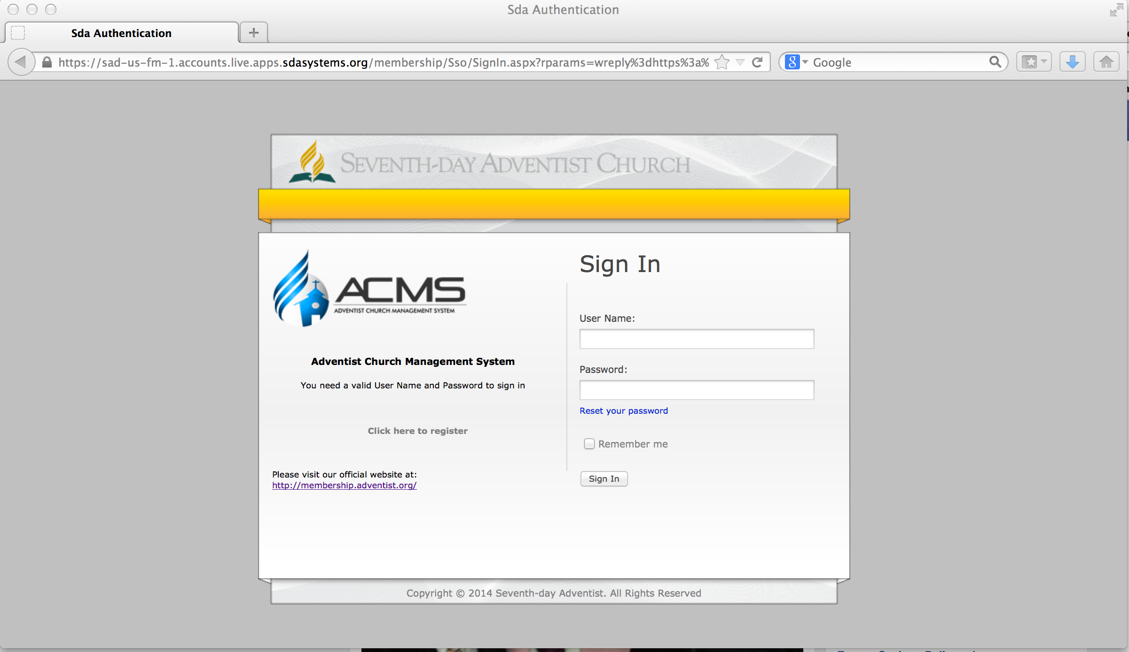
ACMS log-in screen

Slide 16
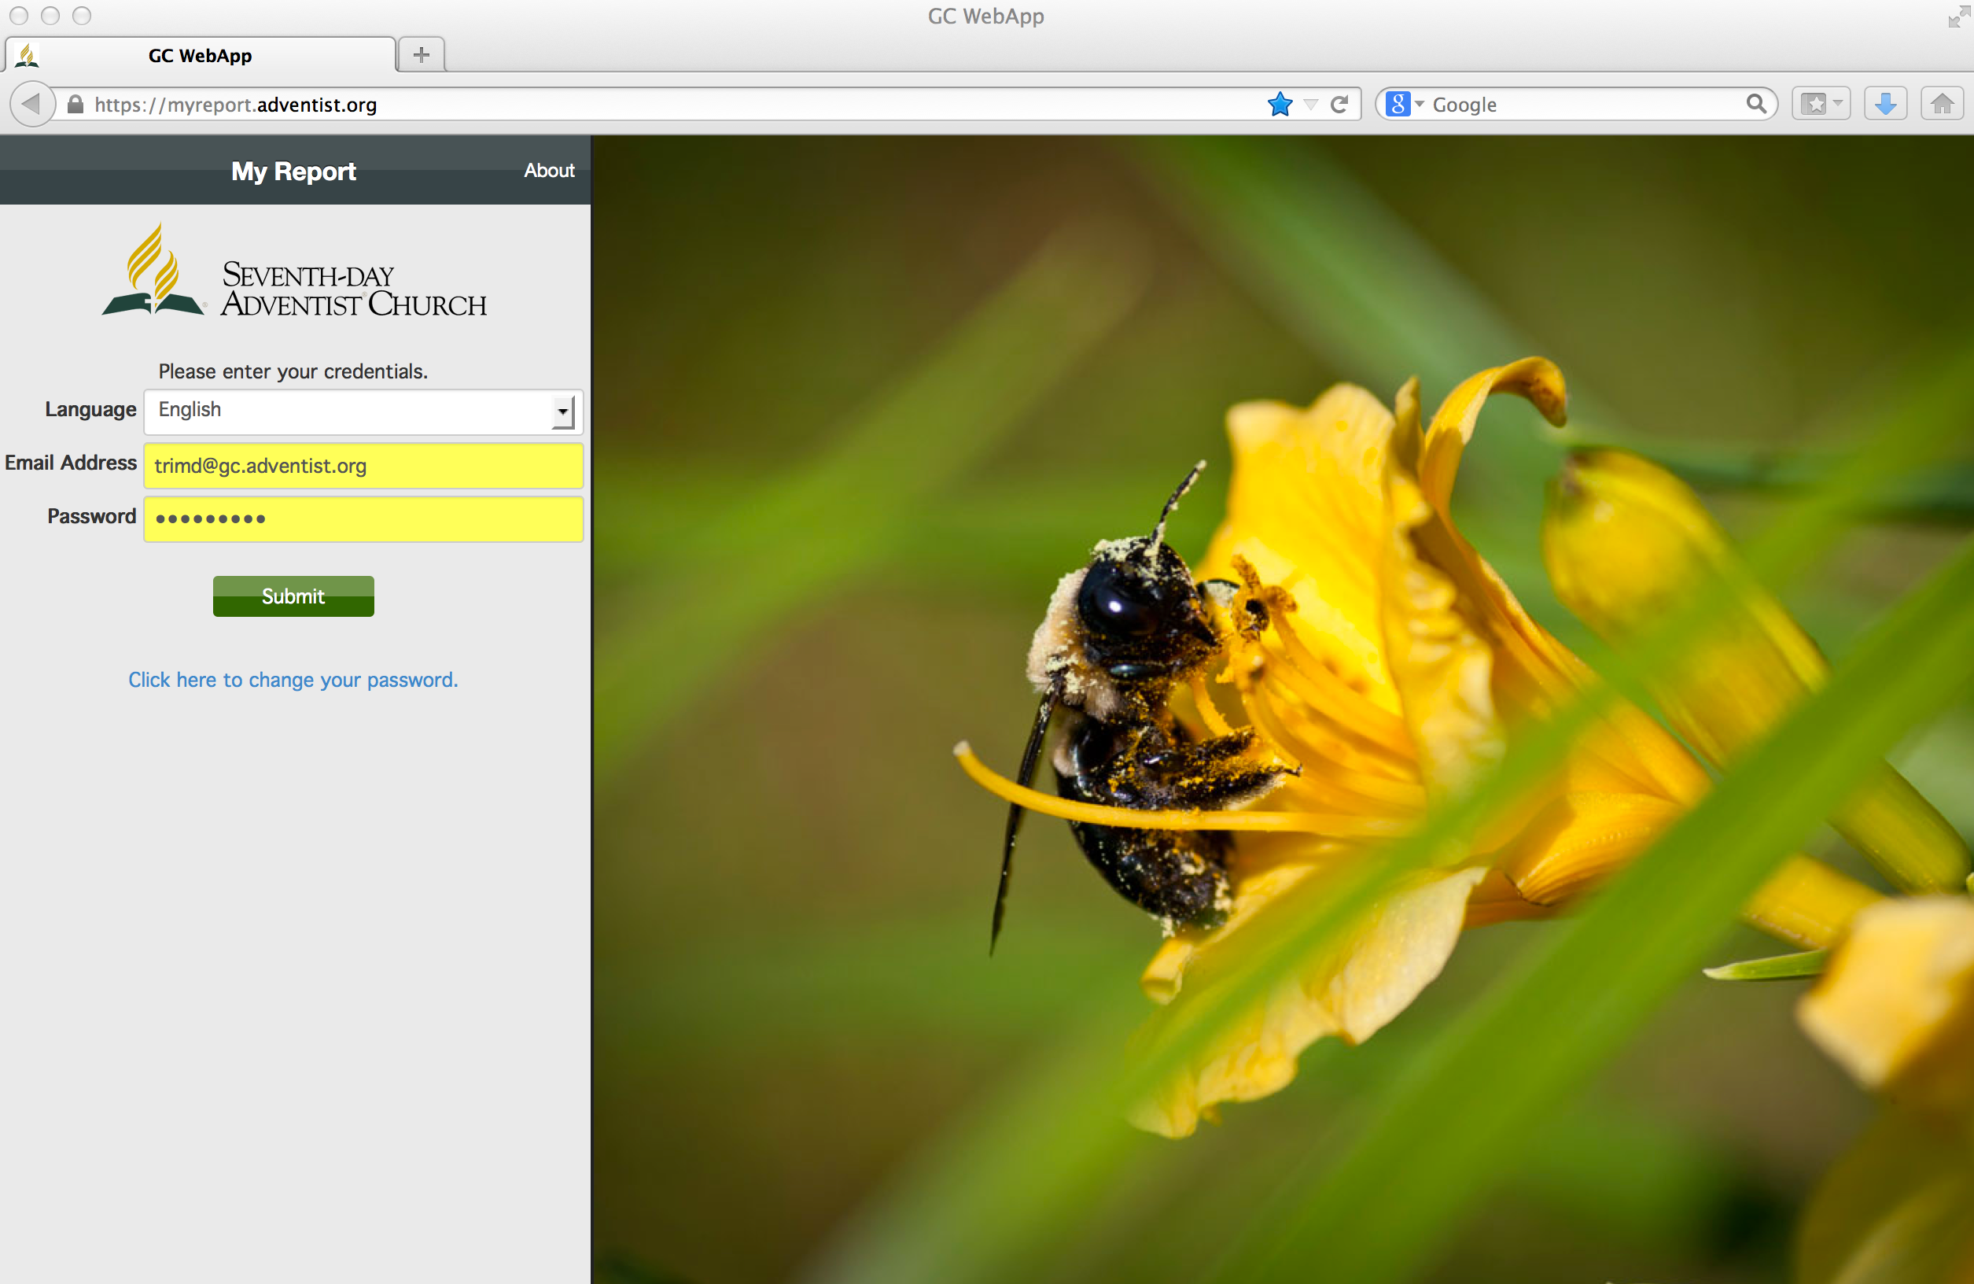
MyReport Log-in Screen

Slide 17
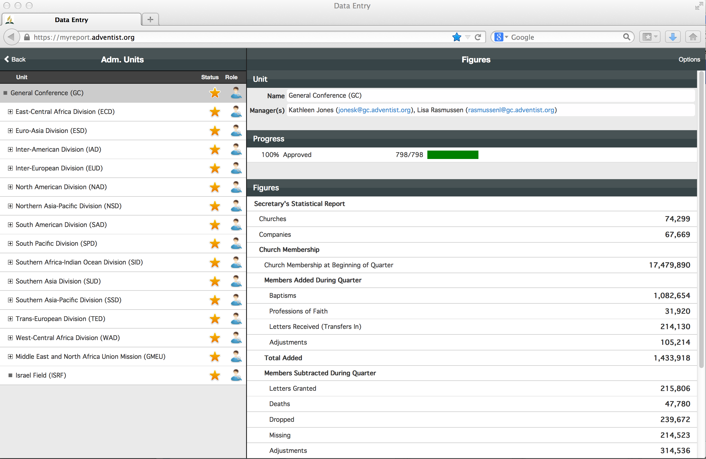
MyReport: 4th Quarter 2012 report screen

Slide 18
Limits to accessibility
Privacy laws around the world mean access to ACMS and eAdventist databases is limited
However, abstract cumulative data will be available, if only through the Annual Statistical Report
Eventually the ASR may be replaced by a statistics web-site updated in real time, increasing the value of church statistics for analysis of trends, etc.
But also, collecting data this way means it is possible to collect far more than traditional official statistics

Slide 19
2. ADVENTIST SCHOLARLY RESOURCES ONLINE

Slide 20
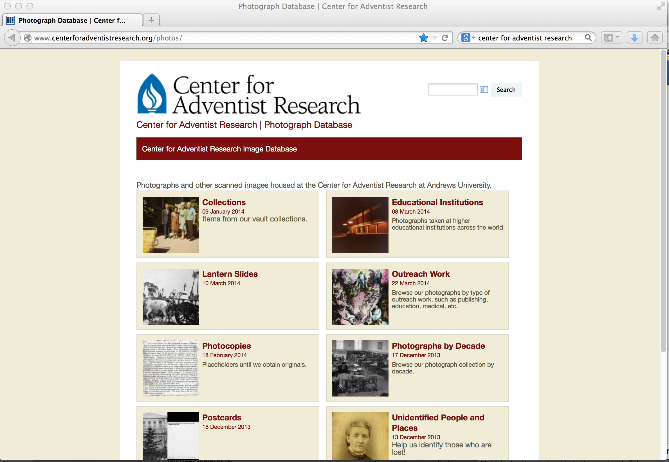
Center for Adventist Research, Andrews University

Slide 21
Seventh-day Adventist Periodical Index

Slide 22
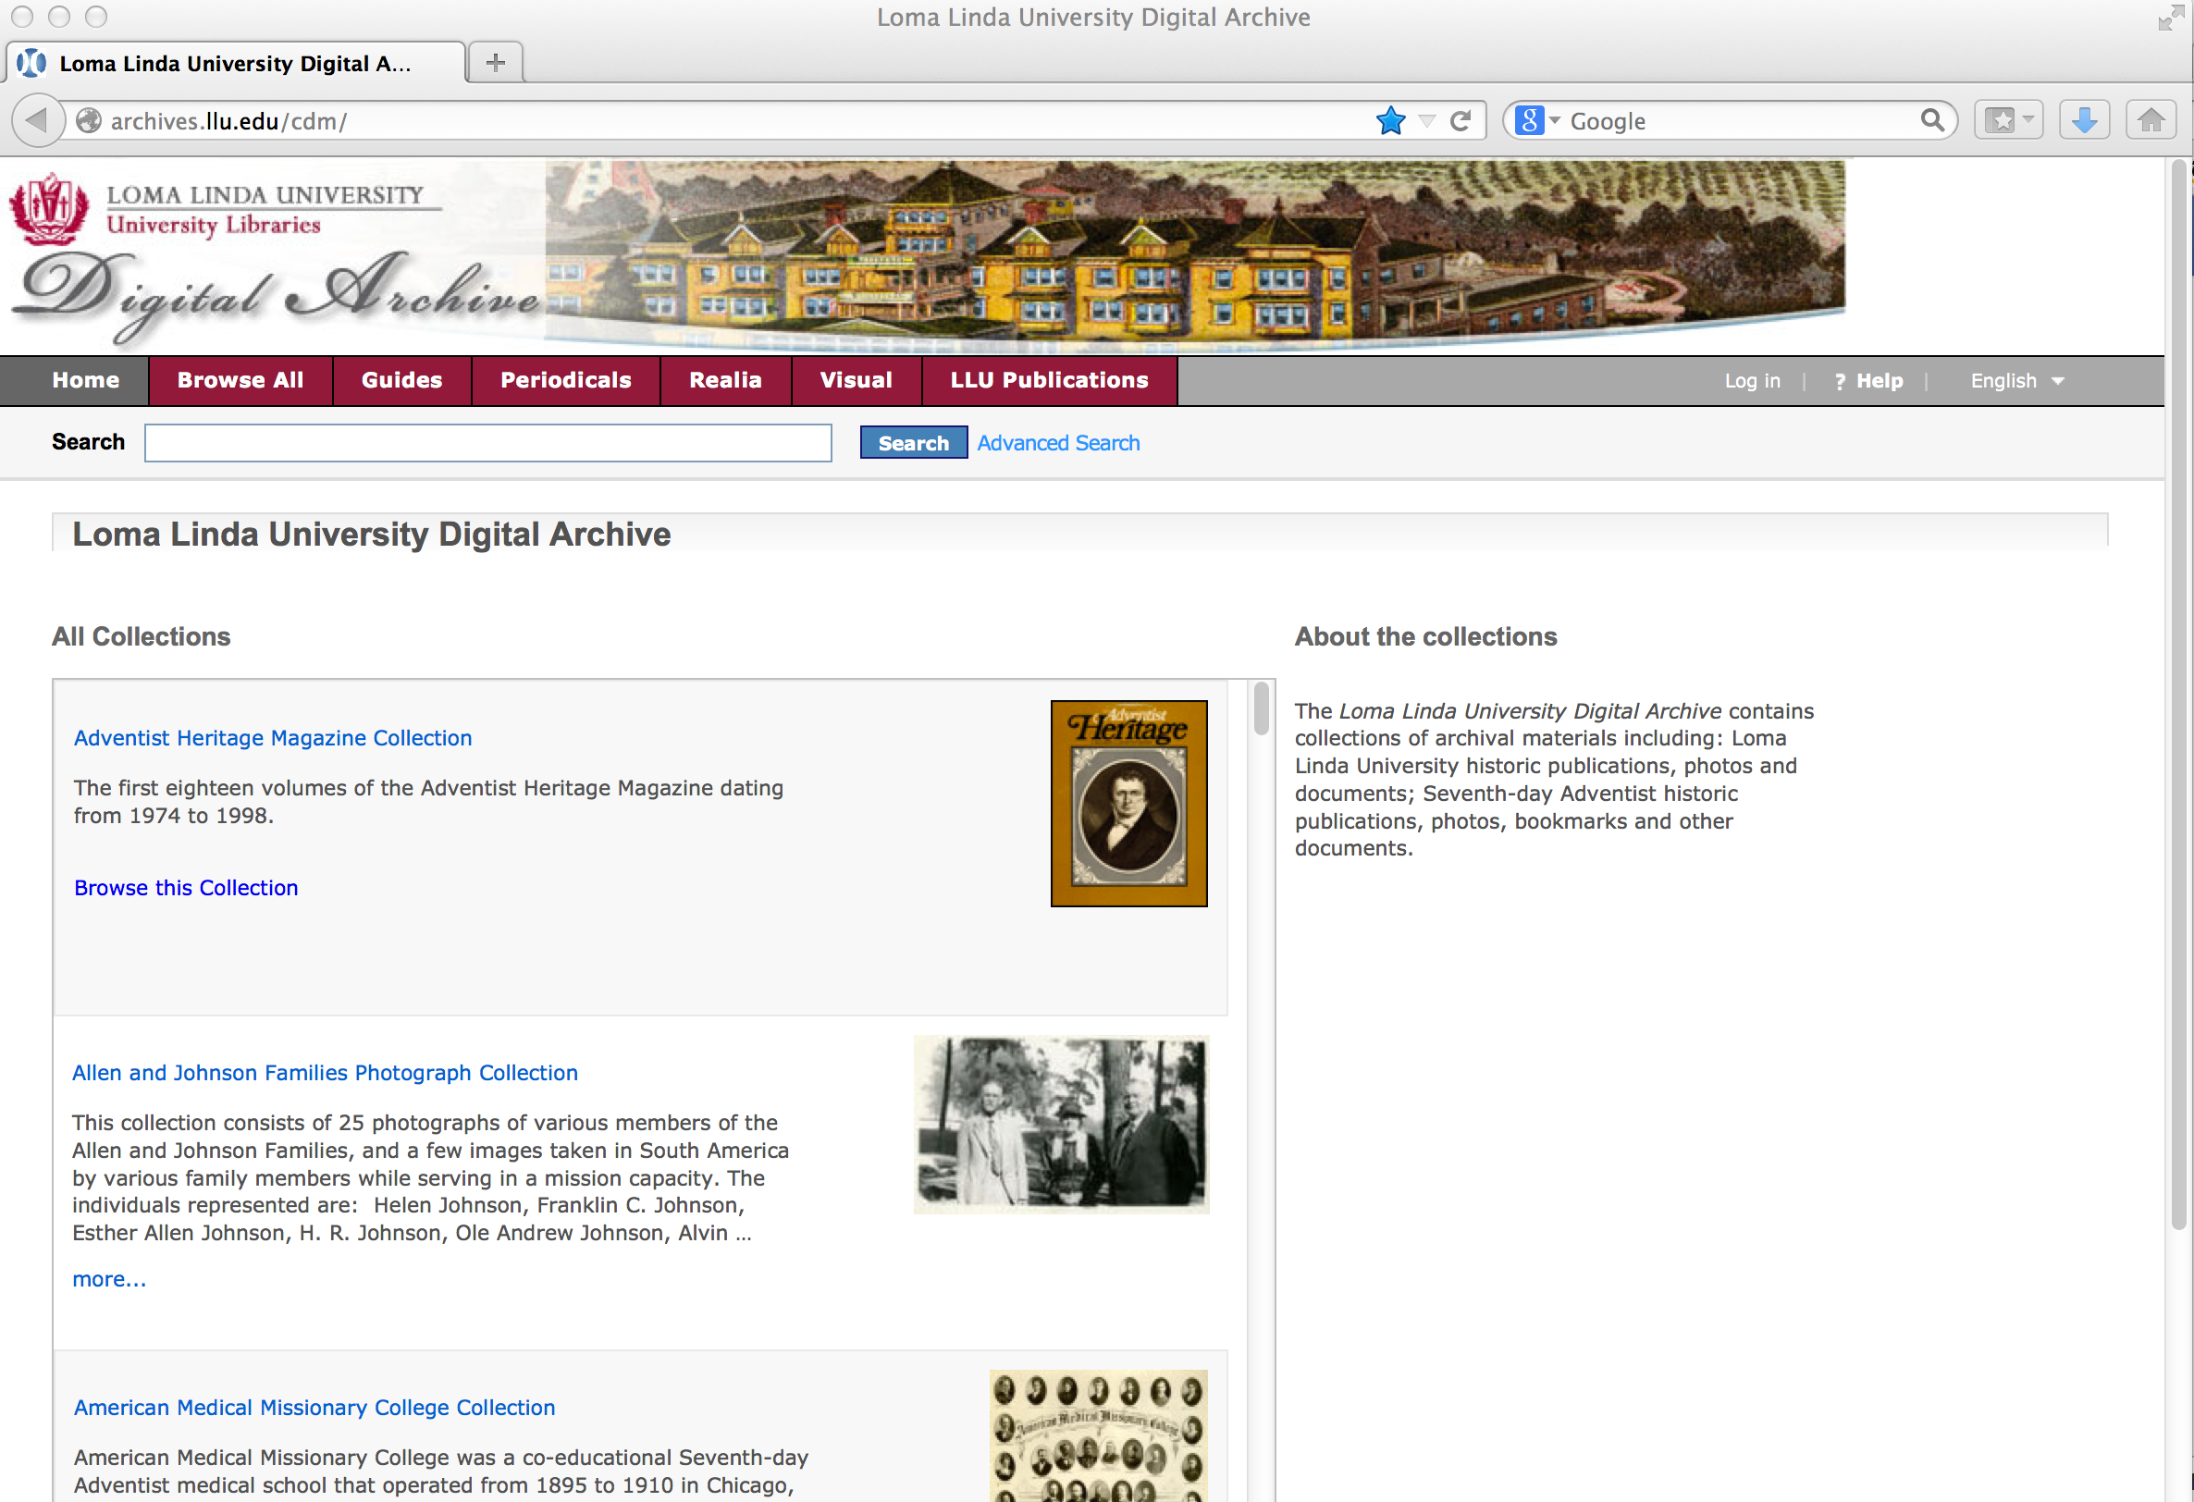
Loma Linda University Digital Archive

Slide 23
UNASP: Centro Nacional de Memória Adventista (Brazil)

Slide 24
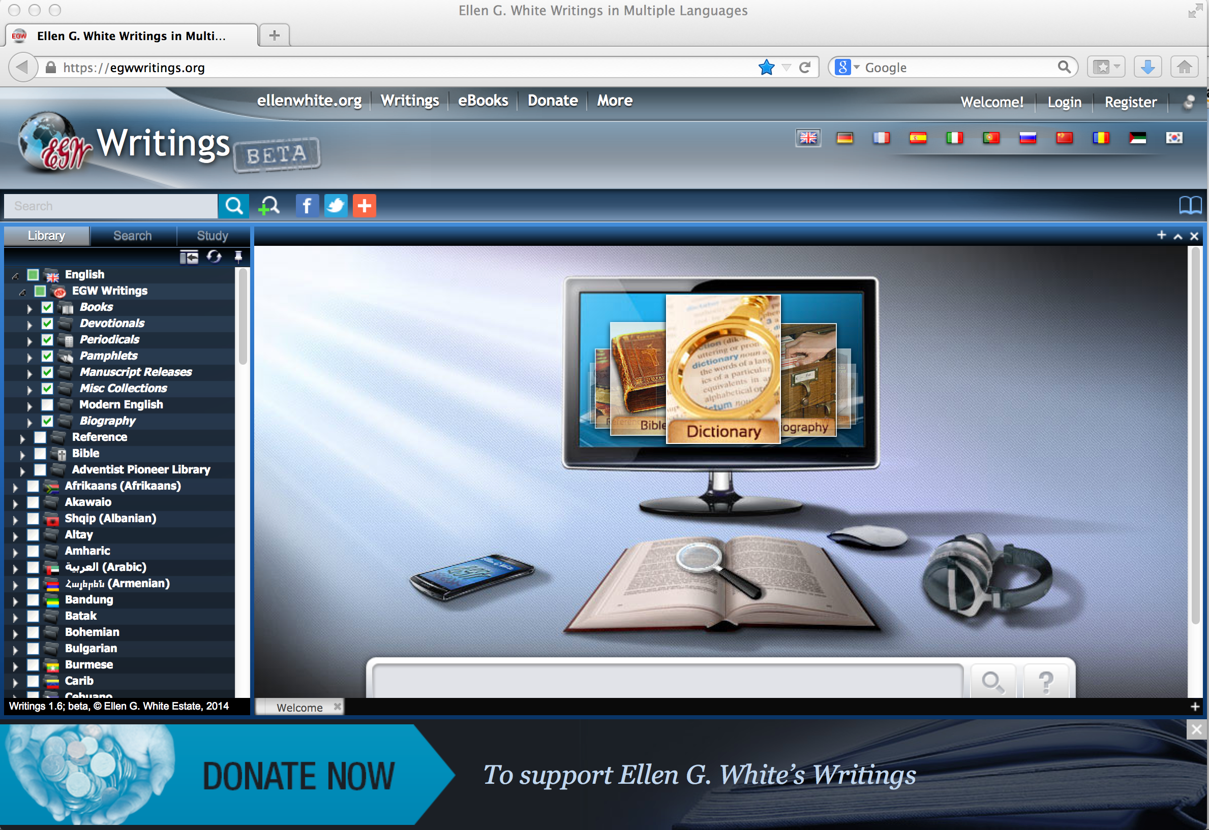
Ellen G. White Writings

Slide 25
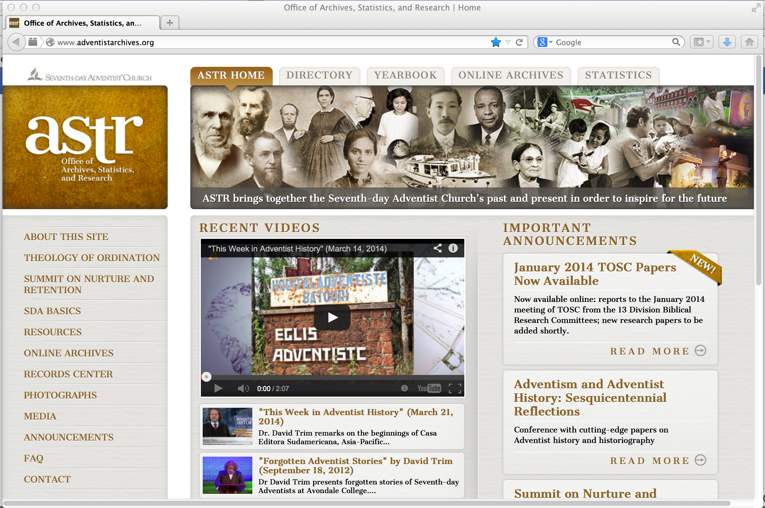
www.AdventistArchives.org—home page for suite of ASTR websites

Slide 26
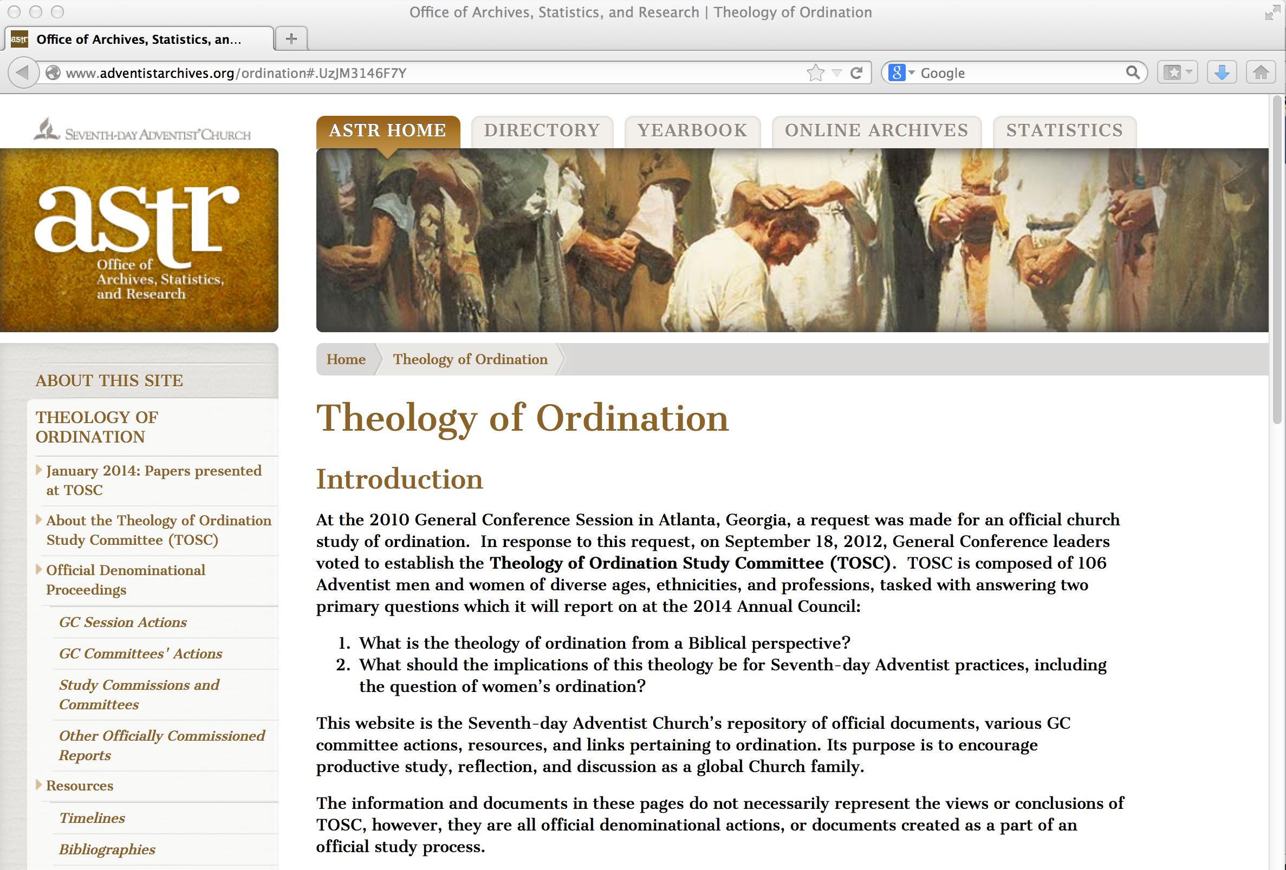
Theology of Ordination Study Committee (ASTR hosts TOSC website)

Slide 27
TOSC website has .pdfs of every paper presented to official denominational
study committees since 1973; also every official action on ordination taken by a GC committee

Slide 28
ASTR also hosts the Nurture and Retention website

Slide 29
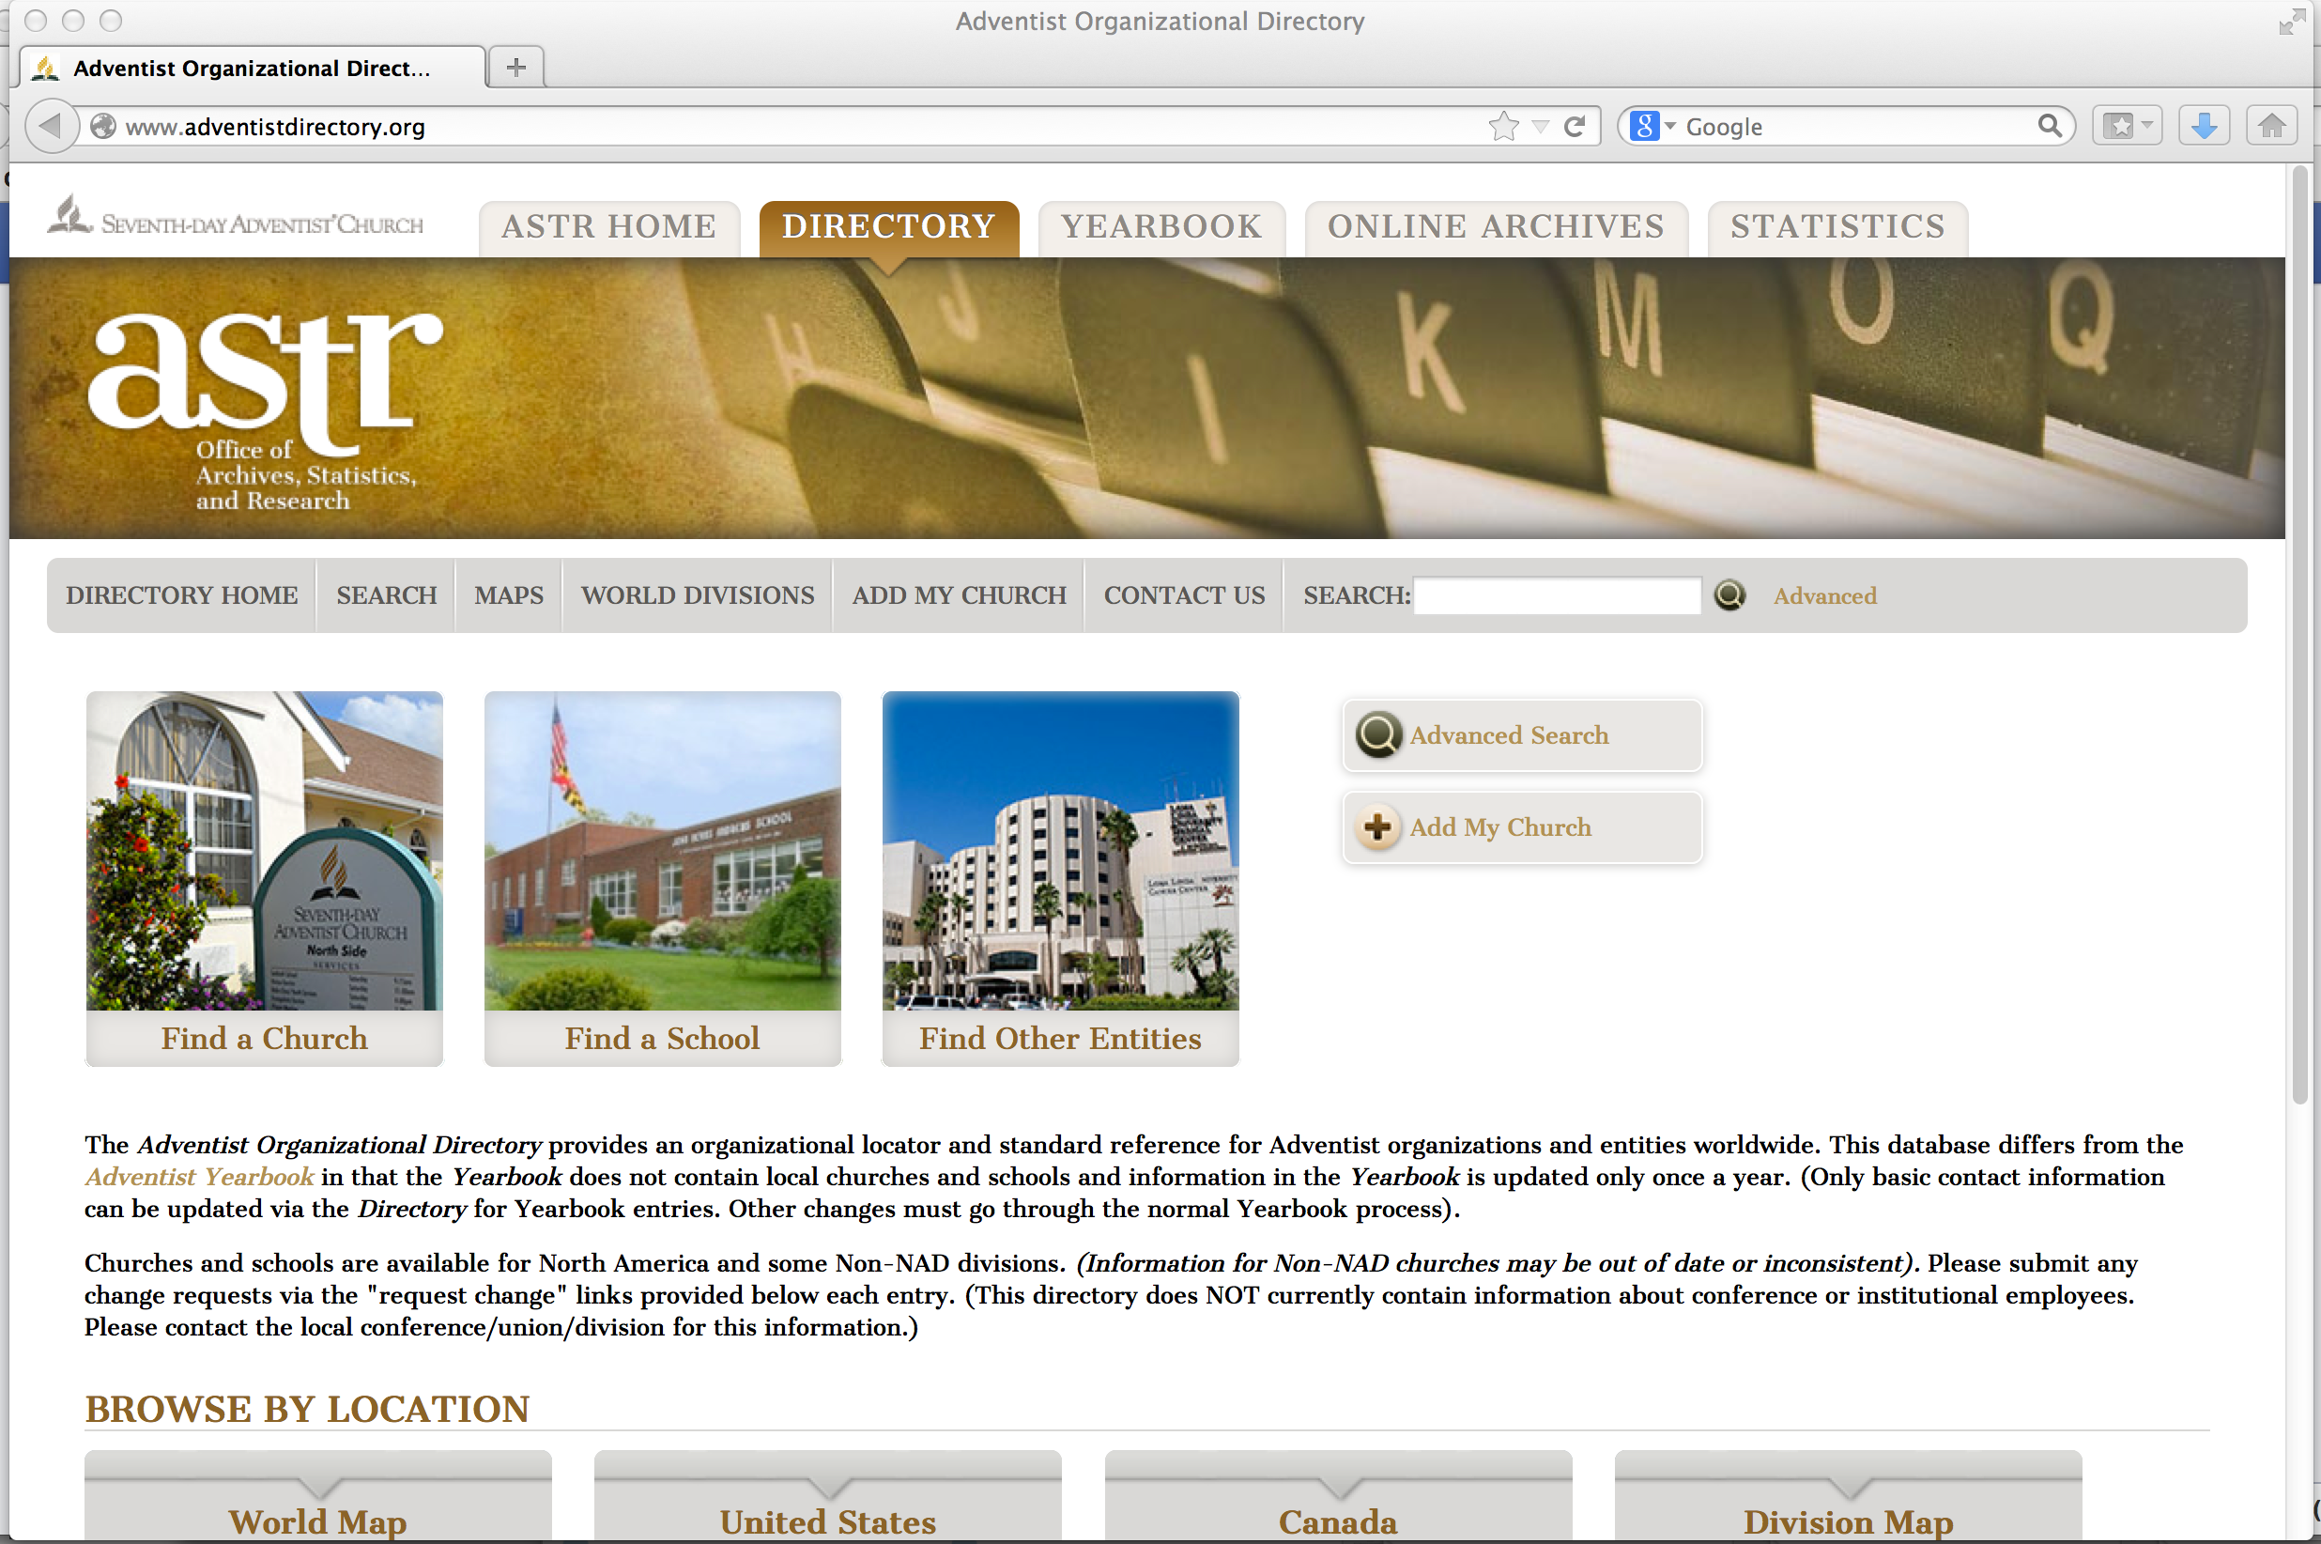
Adventist Directory

Slide 30
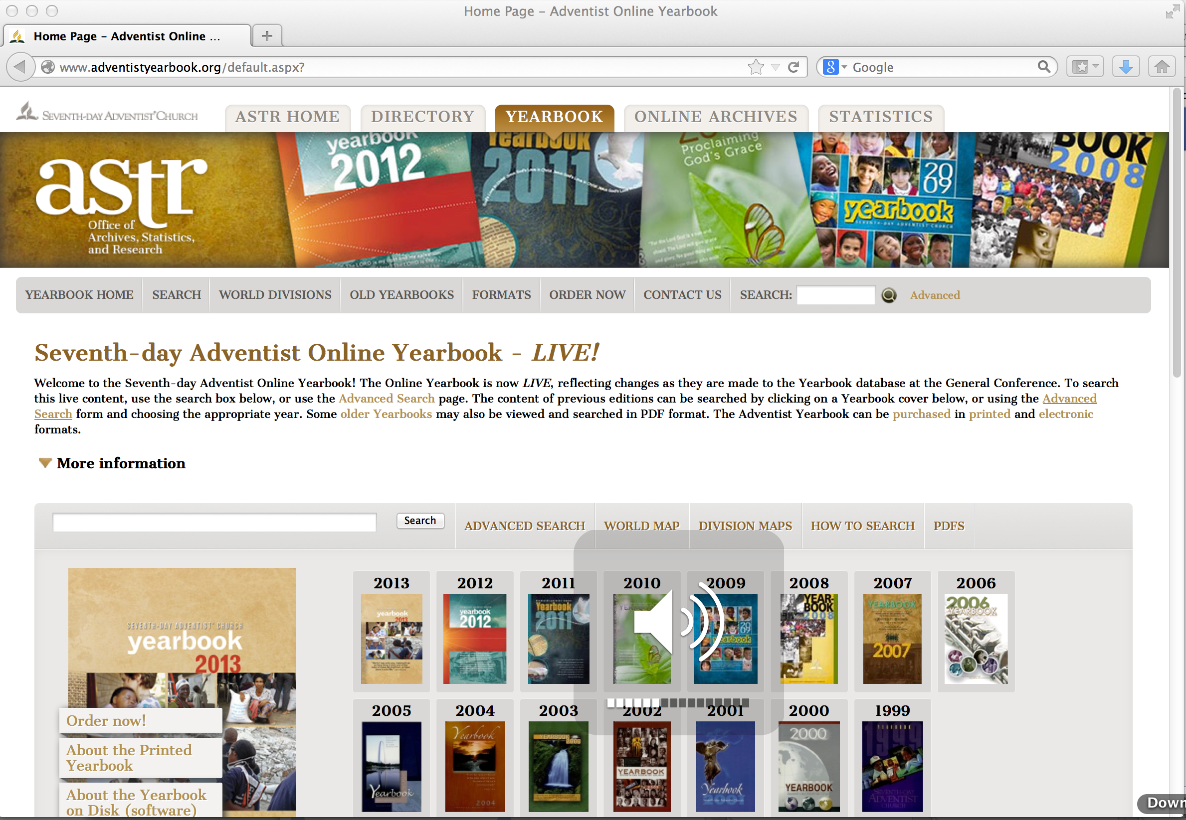
Adventist Yearbook

Slide 31
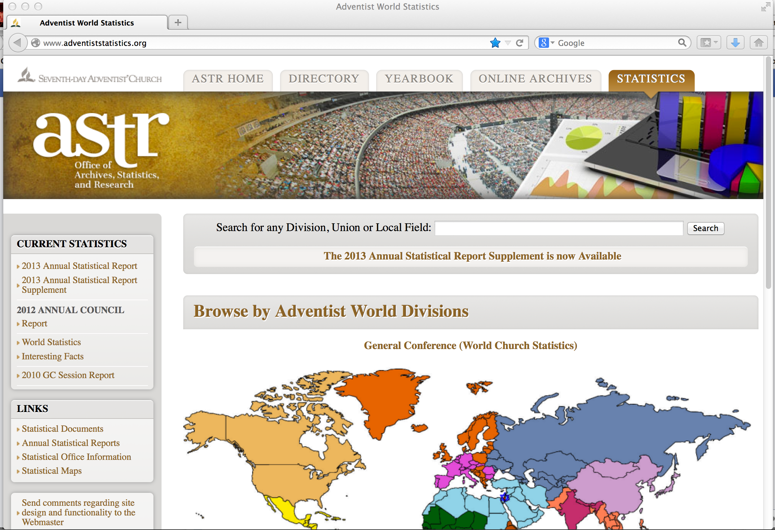
Adventist Statistics—download statistics for any area, any period, to Excel!

Slide 32
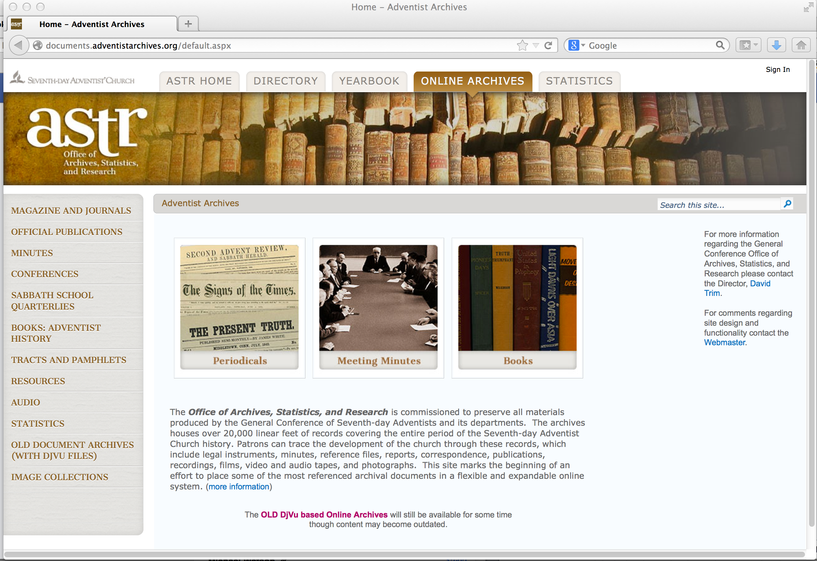
Online Adventist archive

Slide 33
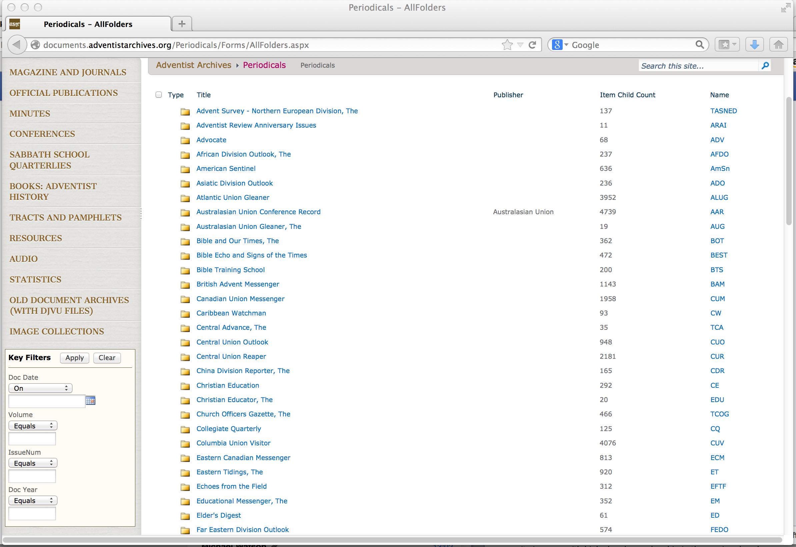
Online archive of official periodicals

Slide 34
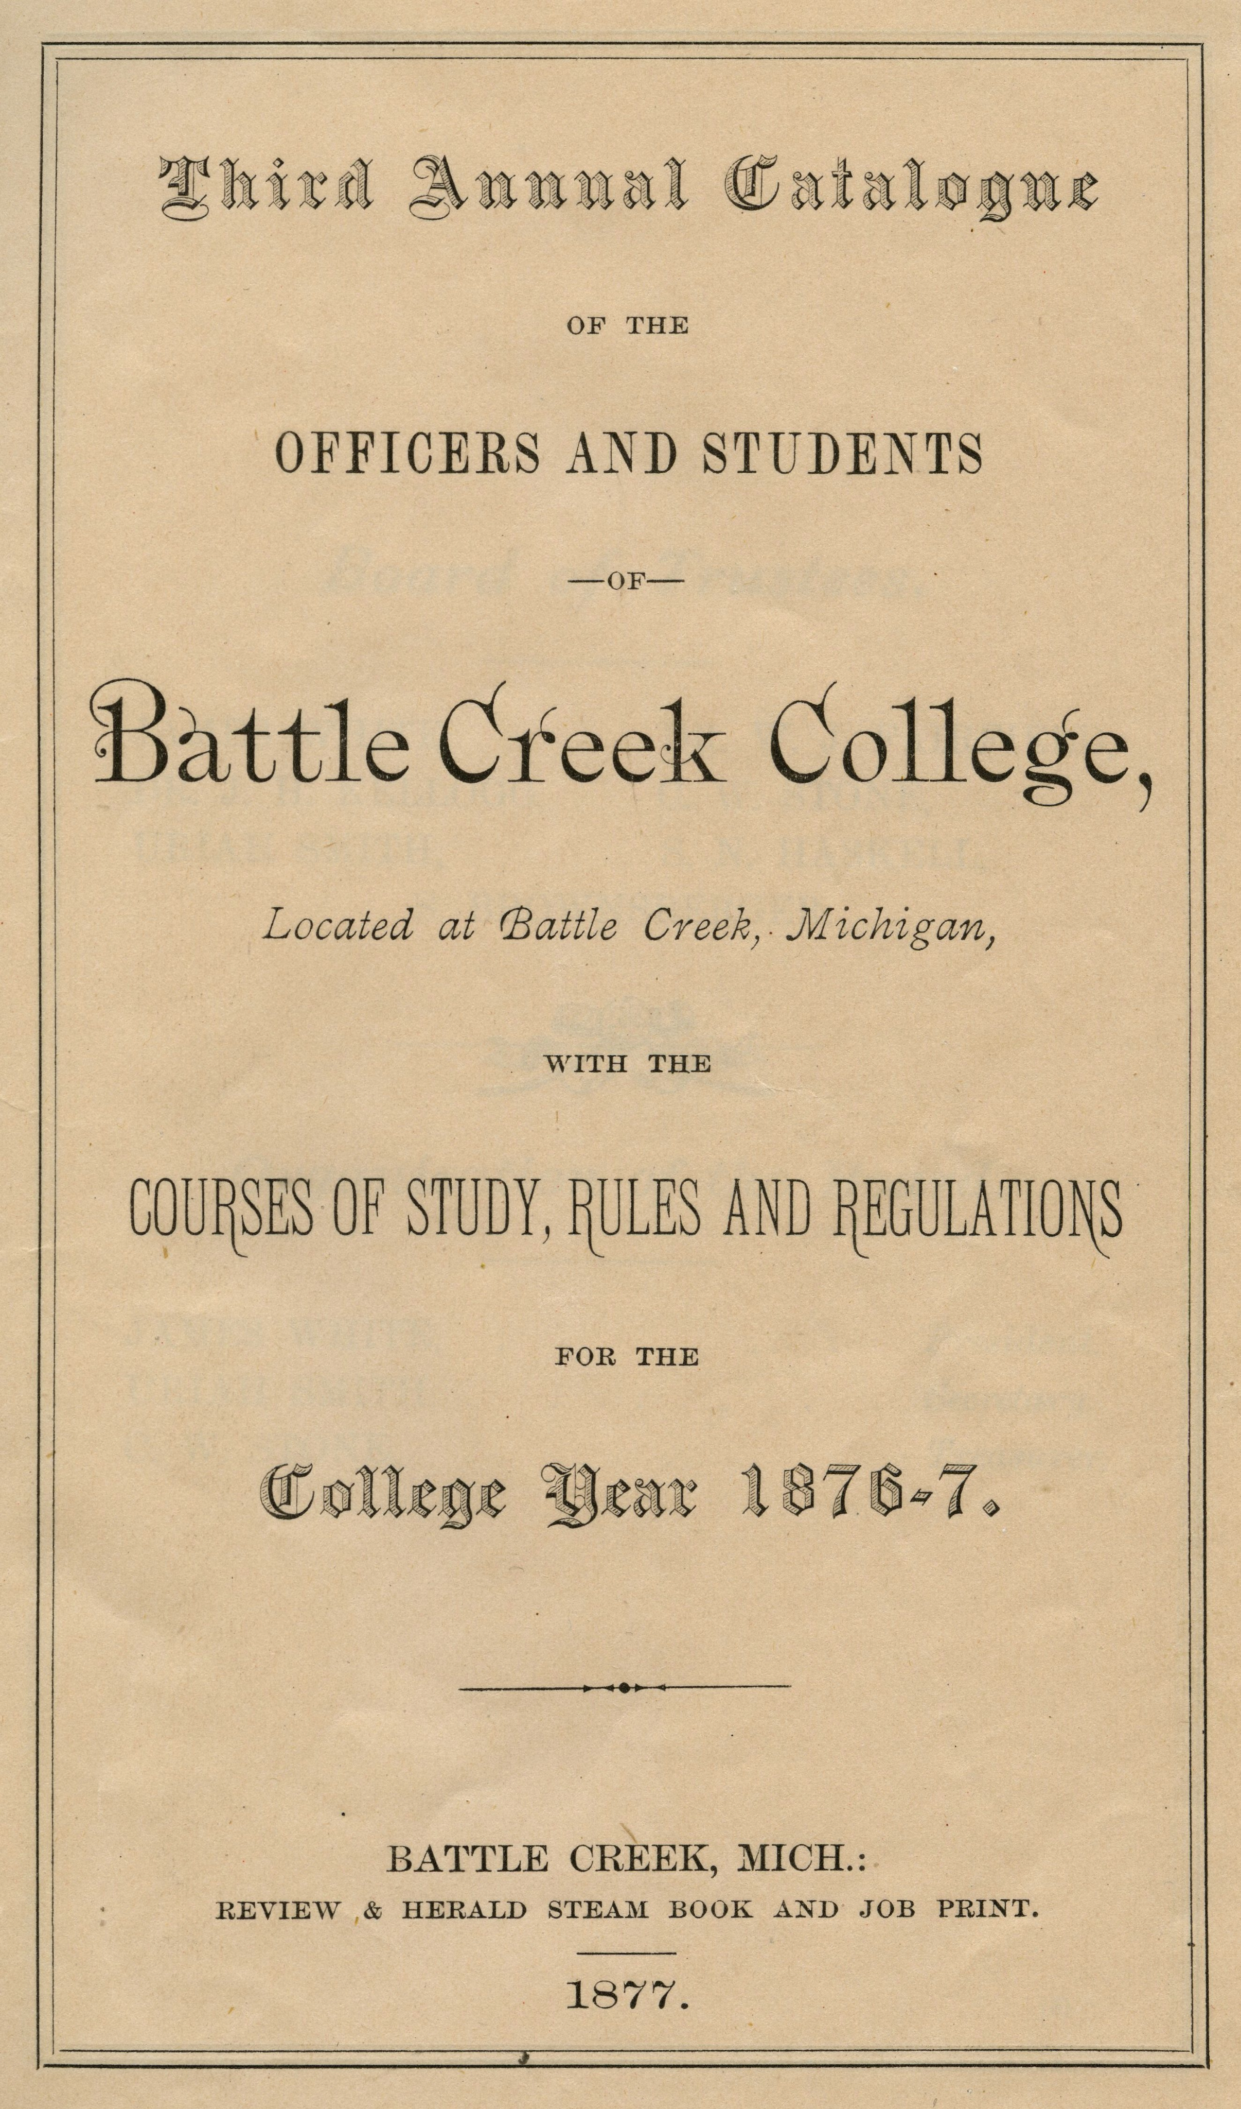

Slide 35
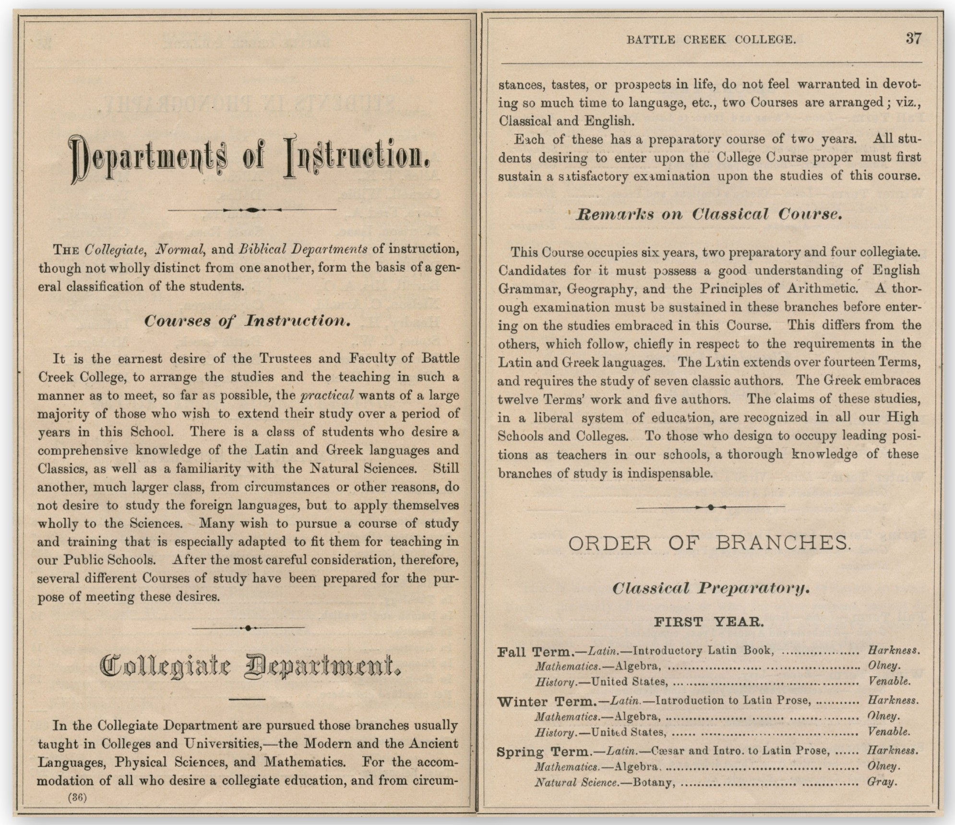

Slide 36
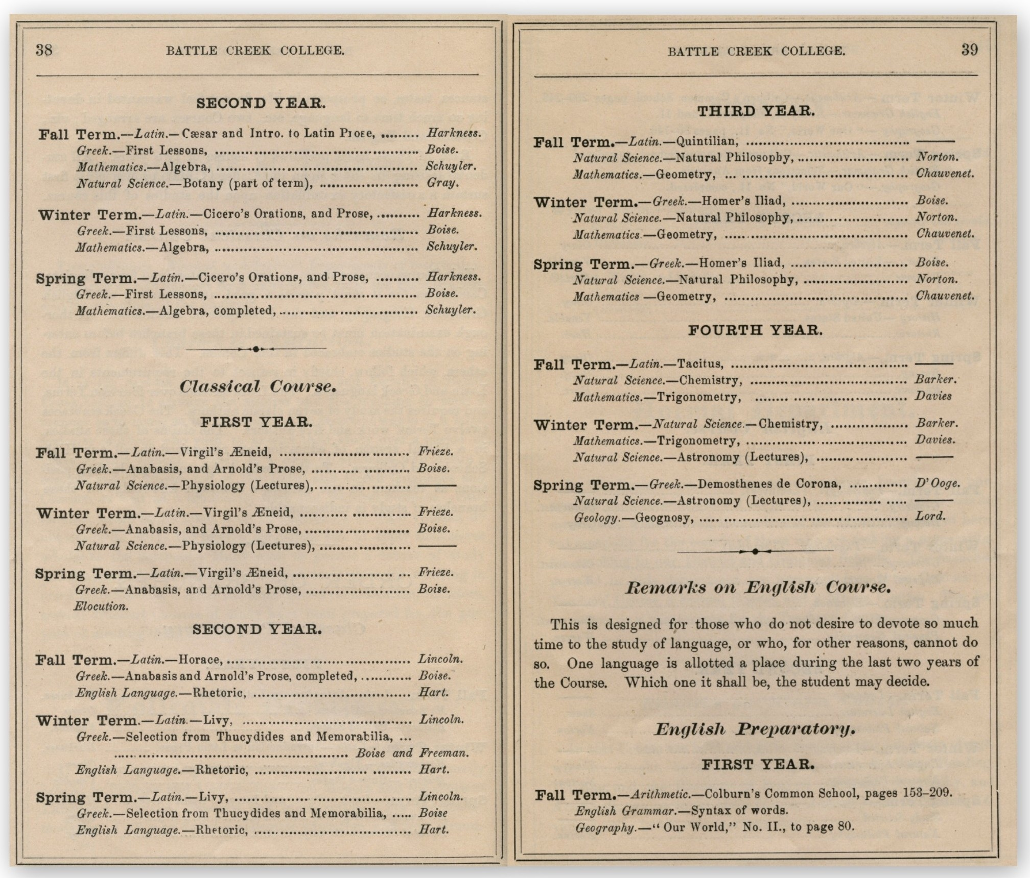

Slide 37
Adventist Digital Library
At present, EGW Estate, the GC Archives, and the Center for Adventist Research (CAR) are the largest online digital collections
Loma Linda and UNASP have significant bodies of materials online
Other universities / colleges are starting to digitise: e.g. Canadian University College, Newbold College, Walla Walla University, Pacific Union College

Slide 38
Adventist Digital Library
But each digital collection has a separate website…
The EGW Estate, CAR and ASTR are working to create a common platform—one portal for historic Adventist materials online:
The Adventist Digital Library (ADL)

Slide 39
Adventist Digital Library
The General Conference has invested heavily in the creation of the Adventist Digital Library, paying for hardware, software development, staff salaries, and incidental costs.
It will be freely available to all church members; but it will give every Adventist higher education institution with web access a world-class research library on Adventist Studies.
Timeframe: we anticipate it will go live before the 2015 GC Session.

Slide 40
Adventist Digital Library
However:
To keep updating the database;
To allow for other institutions to add their digitised materials;
To translate materials into other languages…
All this has a cost. Thus, in order for the ADL to be an optimal asset for teaching, learning and scholar-ship, it needs ongoing financial support from Adventist higher education institutions, on top of the initial investment by the General Conference.

Slide 41
Optimising existing resources
Even before the ADL goes live, however, the wealth of resources on the White Estate and GC Archives websites (in particular) are still easily accessible.
And there are possibilities for GC Archives to help publicise the research being done by your faculty and students, or hosted at your institution.

Slide 42
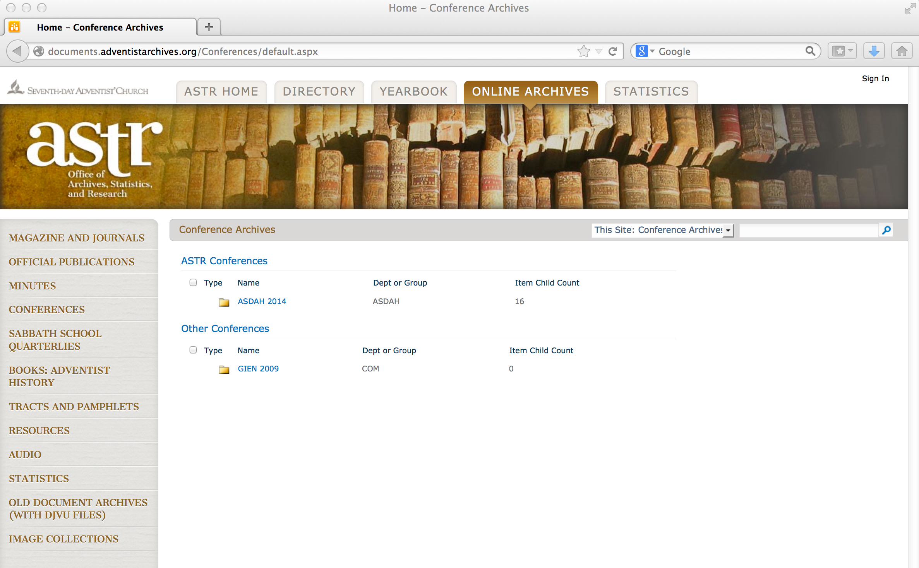
Available at ASTR’s Online Archive: a dedicated section for posting papers from conferences—often difficult to publish a
conference’s proceedings, but this is a way to make them available

Slide 43
3. ANALYSING “BIG DATA” FOR MISSION PURPOSES

Slide 44
Consumer demographics applied to evangelism
Demographic and sociological profiling of areas prior to outreach plans can be transformed.
Examples of “big data” available in many countries or regions: spending patterns, transport use, reading patterns—all from credit card and loyalty program data.
Many conferences would like to have this data, so that outreach methods can be tailored; but not all have staff with necessary analytical skills.

Slide 45
Using crowd sourcing
Denominational institutions often supply multiple and contradictory addresses; this makes mapping (for analytical purposes) and insurance difficult.
Rather than paying for numbers of buildings and their addresses to be verified, a university could set up a project for students to take cell-phone photos of all the buildings in a given conference or union, which could be geo-coded by the phone and then uploaded to a website.

Slide 46
4. SOME RESULTS OF ADVENTIST-RELATED RESEARCH

Slide 47
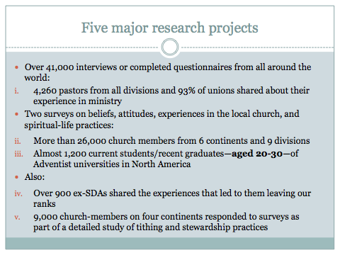

Slide 48
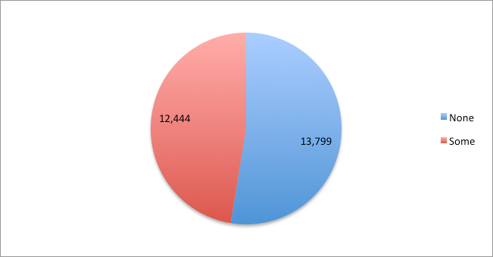
Respondents with some Adventist Education
None = 52.58%
Some = 47.42%

Slide 49
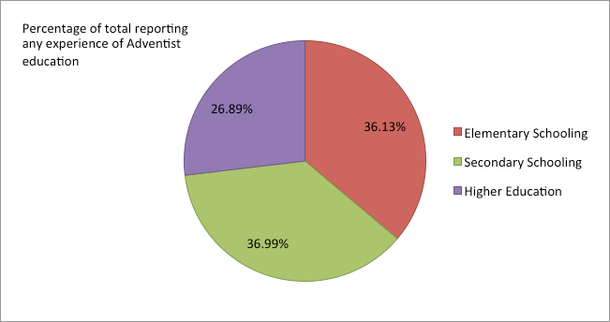
Experience of different levels of Adventist education

Slide 50
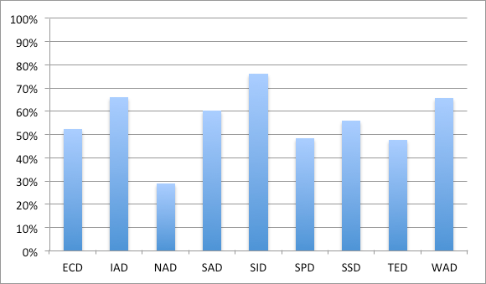
Percentage with no Adventist education, per Division

Slide 51
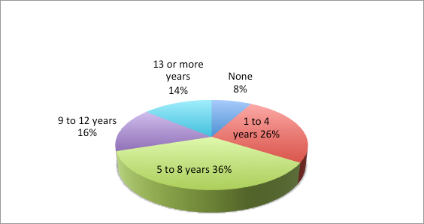
Pastors’ experience of Adventist Education

Slide 52
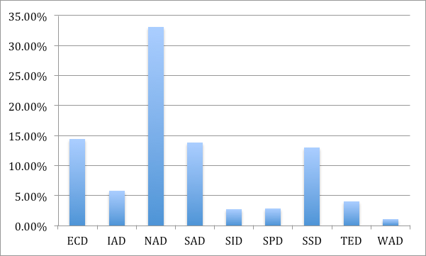
Respondents with experience of SDA higher education: division-by-division share

Slide 53
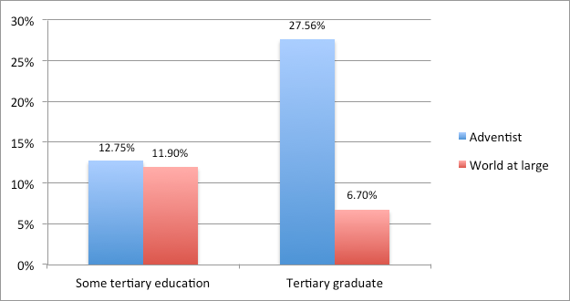
Adventist experience of higher education in context
Percentage of persons who
completed secondary school
Robert J. Barro & Jong-Wha Lee, “A new data set of educational attainment in the world, 1950–2010”, National Bureau of Economic Research, Working Papers, no. 15902 (April 2010), p. 32

Slide 54
Adventist education is a spiritual safeguard
In surveys of lapsed and ex-Adventists, 83% report no experience of Adventist education
However, the equivalent figure for all church-members is 56%
Those who have not gone through Adventist education are disproportionately more likely to become inactive or leave
60% of pastors believe that members who have not experienced Adventist higher education are more likely to leave the church
The Valuegenesis studies documented that Adventist primary and secondary education strongly correlates with being retained by the Seventh-day Adventist Church—but only for North America.
Data from the recently concluded research is a very strong prima facie indication that the model in NAD obtains globally and for tertiary education

Slide 55
Conclusion
These examples have hopefully given some sense of how Adventist colleges and universities can exploit existing online digital resources for scholarship and teaching, and of the opportunities that will present themselves as our “denomination goes digital”
It also shows how research can be of immense value for the Church in general and tertiary institutions in particular

Slide 56
Conclusion
What, then, is the agenda for the twenty-first century?
Universities and colleges, as much as possible, should invest in research, regarding themselves not simply as teaching or training institutions, but as intellectual resource centres for enhancing the mission & ministry of the Church in their area.
They should proactively reach out to administrators offering their faculty’s unique analytical expertise.

Slide 57
Conclusion
Agenda for the twenty-first century (cont.)
Universities and colleges can contribute to the “big data” picture of their society and the wider Church, and can make resources available online—especially in partnership with projects like the ADL
Our tertiary faculty and students have unique skill sets and knowledge bases; and educational leaders should be seeking ways to maximise them to aid the mission of the Seventh-day Adventist Church.

